Slide 1
Metodología de la investigación cuantitativa FIBHUG
Stefan Walter y Ángel Rodríguez

Slide 2
13 Absence of evidence is not evidence of absence

Slide 3
Outline
Controlled Trials
Linear Regression and Regression to the Mean
Survival Analysis
Odds Ratio
Diagnostic Tests
Transformation
Interaction
Missing Data

Slide 4
1. Controlled trials (Altman, Bland, Day, Schulz, Vickers, Kerry)
39. Treatment allocation in controlled trials: why randomise?
41. How to randomise.
50. Treatment allocation by minimisation.
44. Concealing treatment allocation in randomised trials.
43. Blinding in clinical trials and other studies.
61. Missing outcomes in randomised trials.
45. Analysing controlled trials with baseline and follow up measures.

Slide 5
Controlled trials
30. Trials randomised in clusters.
31. Analysis of a trial randomised in clusters.
32. Weighted comparison of means.
33. Sample size in cluster randomisation.
34. The intra-cluster correlation coefficient in cluster randomisation.

Slide 6
2. Linear Regression and Regression to the Mean
1. Correlation, regression, and repeated data
2. Regression to the mean
7. Some examples of regression to the mean

Slide 7
3. Survival Analysis
36. Time to event analysis
38. Survival probabilities (Kaplan-Meier method)
48. The log-Rank test

Slide 8
4. Odds Ratio
42. The odds ratio and logistic regression

Slide 9
5. Diagnostic Tests
3. Diagnostic tests 1: sensitivity and specificity
4. Diagnostic tests 2: predictive values
5. Diagnostic tests 3: receiver operating characteristics
49. Diagnostic tests 5: likelihood ratios

Slide 10
6. Transformations
17. Transforming Data
16. Logarithms
18. Transformations, means, and confidence intervals
19. The use of transformations when comparing two means

Slide 11
7. Interaction
24. Interaction 1: Heterogeneity of effects
25. Interaction 2: compare effect sizes not P values
26. Interaction 3: How to examine heterogeneity

Slide 12
8. Missing Data
53. Missing data

Slide 13
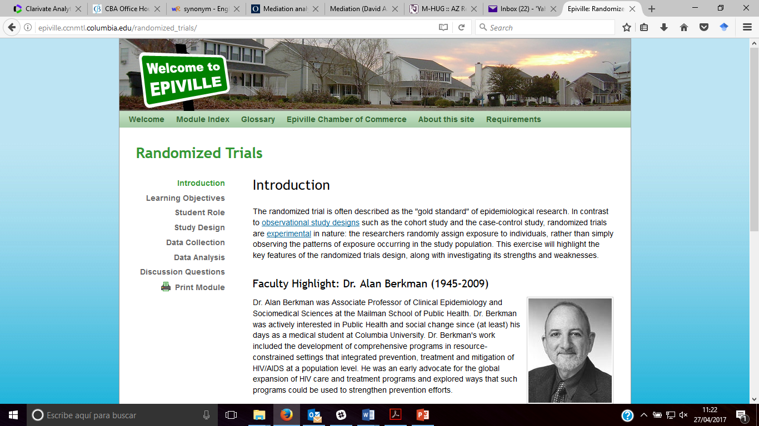
Controlled trials. Apoyo: Epiville
http://epiville.ccnmtl.columbia.edu/
Randomized trials: http://epiville.ccnmtl.columbia.edu/randomized_trials/

